Slide 1
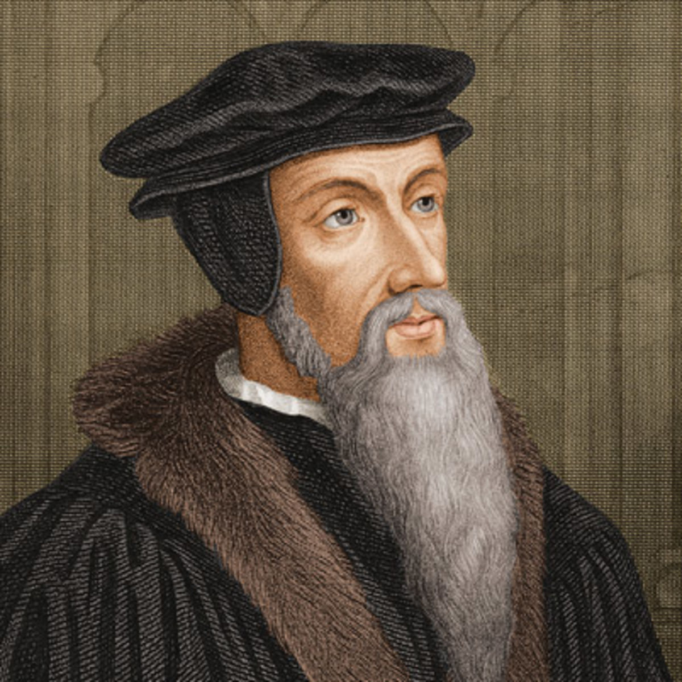
Calvinism – Reformed Theology
John Calvin (1509-1564)

Slide 2
Calvinism – Reformed Theology
T – Total Depravity (Inability)
U – Unconditional Election
L – Limited Atonement
I – Irresistible Grace
P – Perseverance of the Saints

Slide 3
T – Total Depravity (Inability)
Claims for inability:
Romans 8:6-8
John 6:44
Refutations of man’s inability:
John 5:39-40
Matt 23:37
Revelation 22:17
Philippians 2:12
1 Peter 1:22

Slide 4
U – Unconditional Election
Claims for unconditional election:
Romans 9:15,21
Ephesians 1:4-6
Ephesians 2:10
2 Timothy 1:9
Refutations of unconditional election:
Jeremiah 18:1-11
2 Peter 3:9
1 Timothy 2:4
Gen. 4:6-7

Slide 5
L – Limited Atonement
Claims for limited atonement:
John 17:9
Matthew 26:28
Refutations of limited atonement:
Hebrews 9:11-12
1 John 2:2
1 Timothy 2:5-6
John 3:16-17
I Timothy 4:10

Slide 6
I – Irresistable Grace
Claims for irresistable grace:
Romans 8:14-15
Refutations of irresistable grace:
Romans 8:1-5
Proverbs 1:24-26
John 5:40
Titus 2:11-12

Slide 7
P – Perseverance of the Saints
Claims for OSAS:
I John 2:19
Romans 8:38-39
John 10:28-29
Refutations of OSAS:
James 5:19-20
Heb. 6:4-6
Heb 10:26

Slide 8
Calvinism – Reformed Theology
T – Total Depravity (Inability)
U – Unconditional Election
L – Limited Atonement
I – Irresistible Grace
P – Perseverance of the Saints

